Slide 1
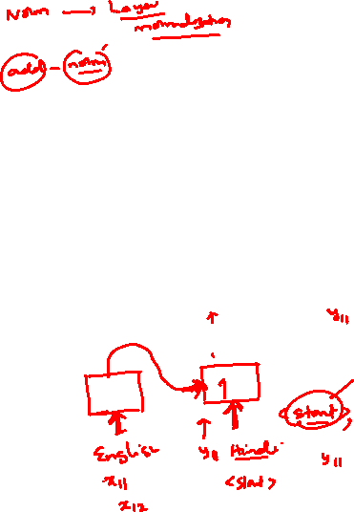
Deep Neural Networks
(AIML ZG511)

Slide 2
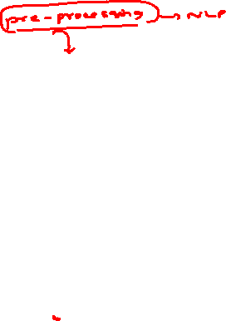
Session 14
(09th August 2026)

Slide 3
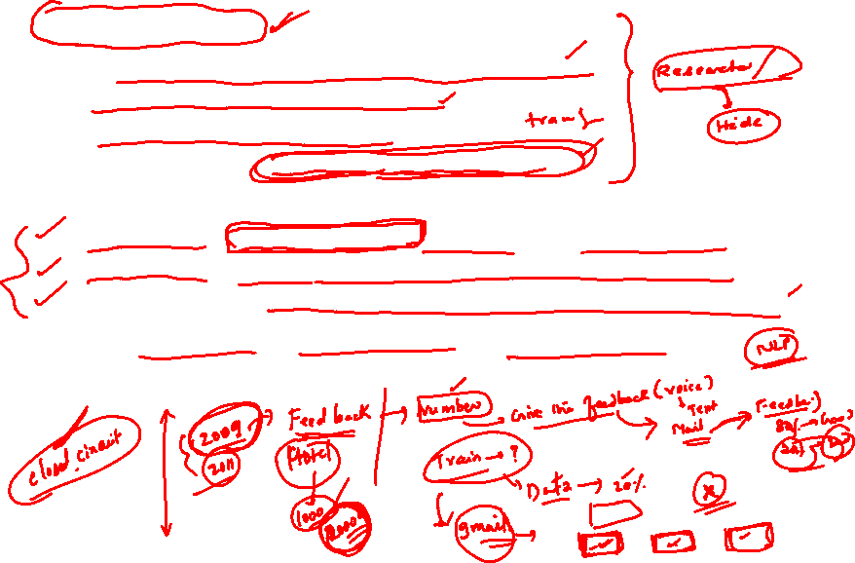

Slide 5


Slide 7


Slide 8

Module 10
Optimizers
Session 14
(09th August 2026)

Slide 9
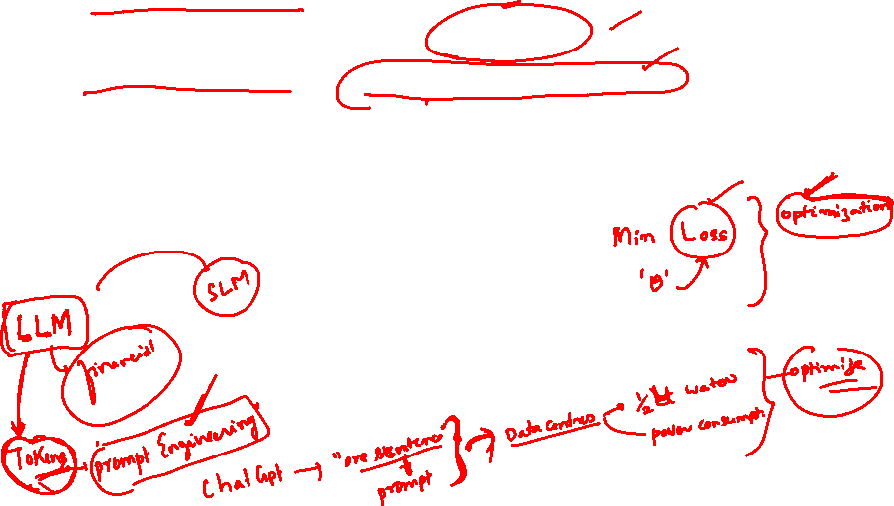

Slide 10
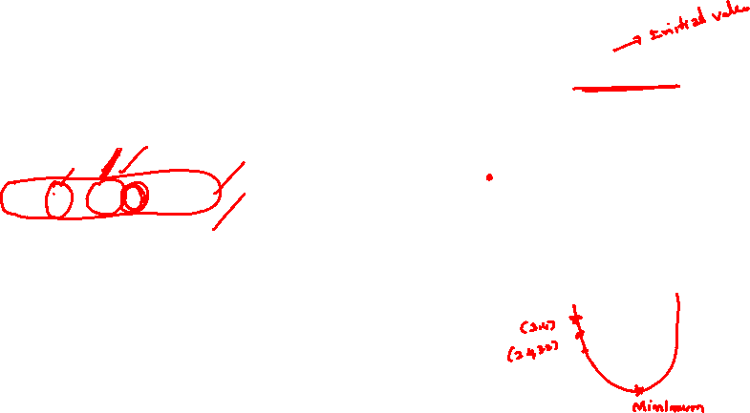

Slide 11


Slide 12
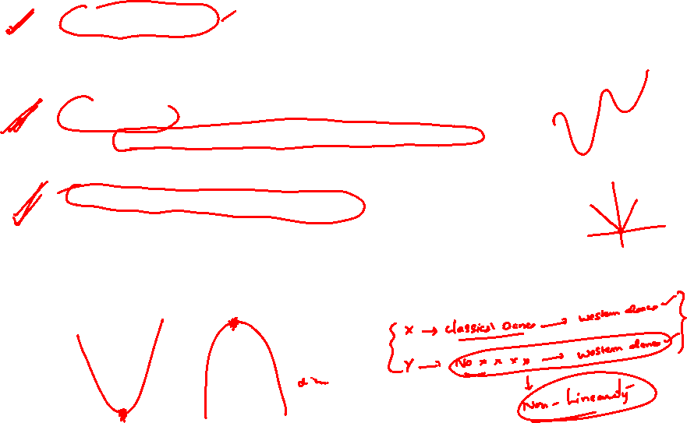

Slide 14
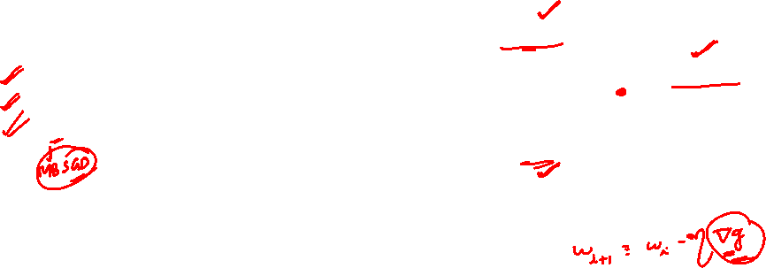

Slide 17
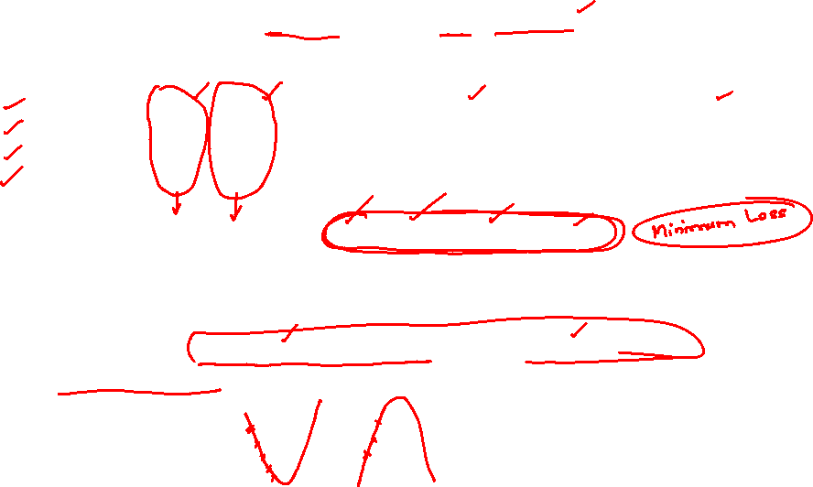

Slide 18
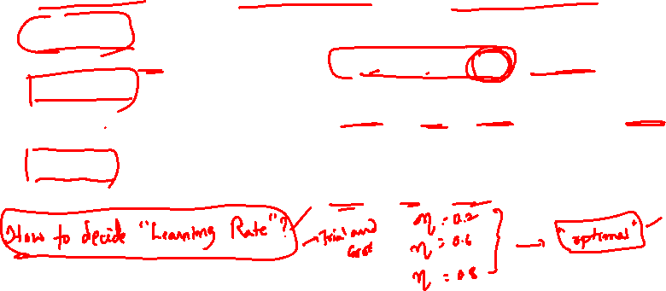

Slide 19
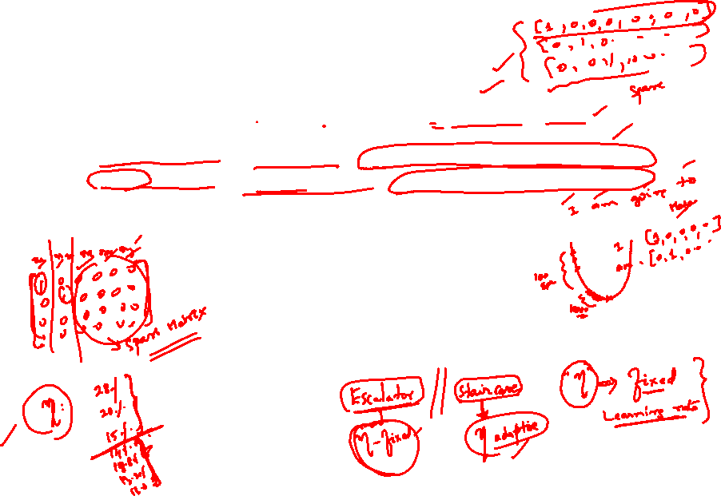

Slide 20
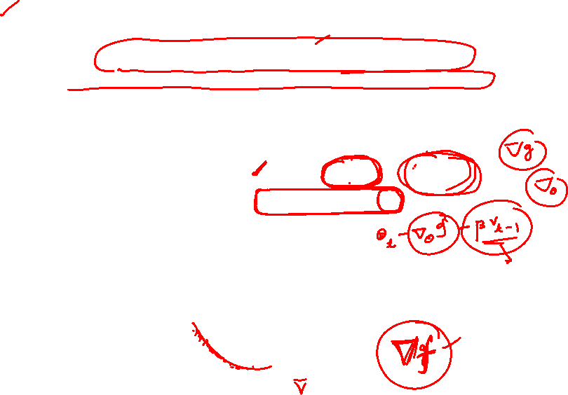

Slide 22


Slide 23
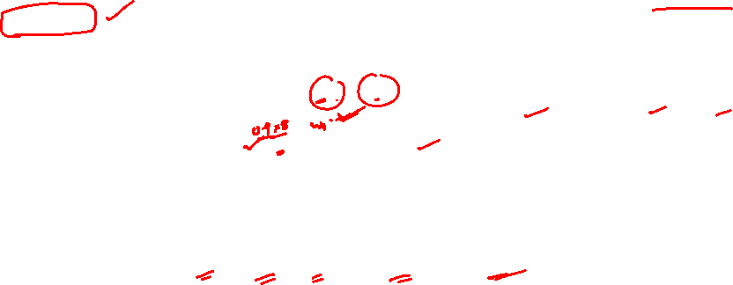

Slide 24
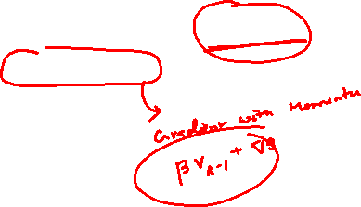

Slide 27
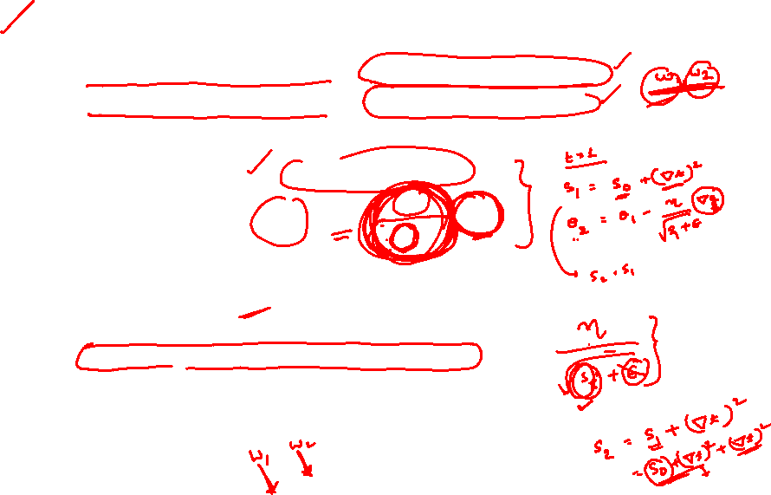

Slide 28
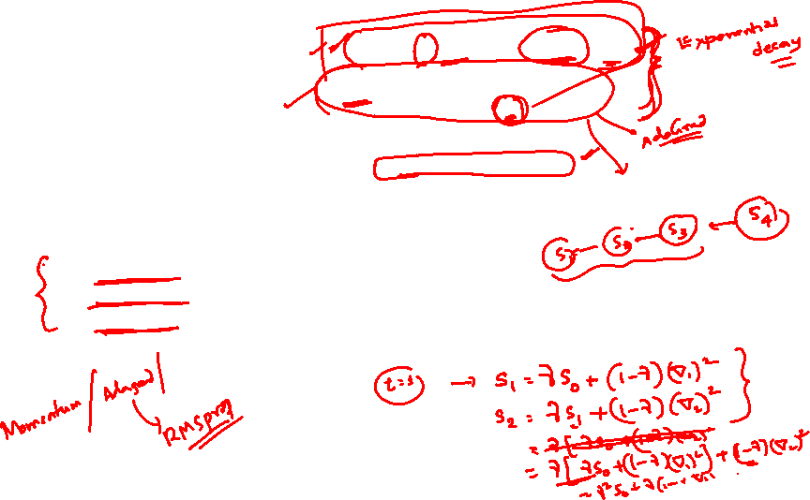

Slide 29
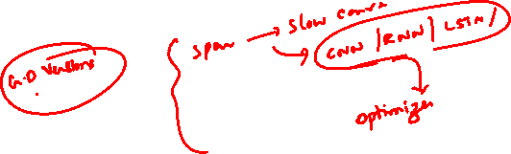

Slide 33
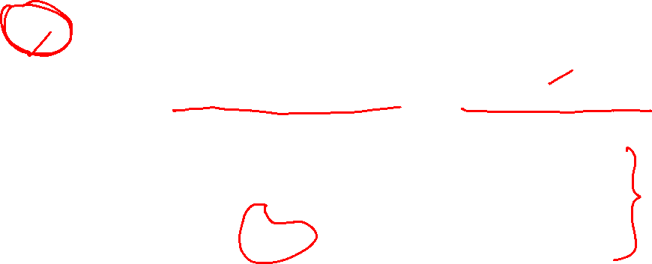

Slide 37
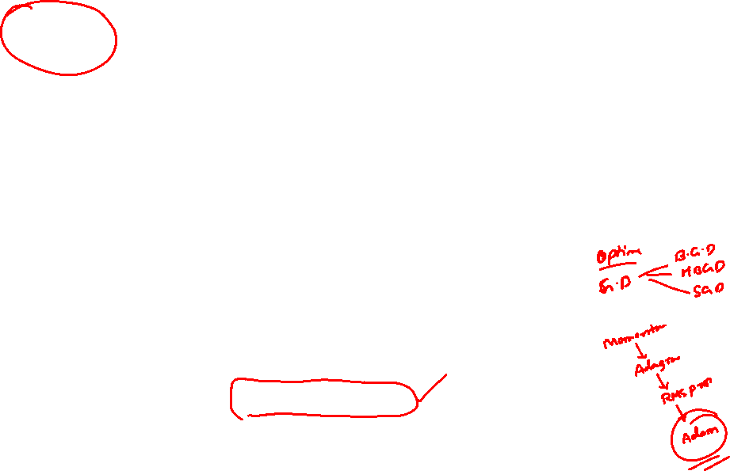

Slide 40

Example
t | xₜ | gₜ = 2xₜ | xₜ₊₁ = xₜ−ηgₜ
0 | 4.000 | 8.000 | 3.200
1 | 3.200 | 6.400 | 2.560
2 | 2.560 | 5.120 | 2.048
 |  |  | x₃ = 2.048
Gradient Descent
gₜ = ∇f(xₜ) = 2xₜ
xₜ₊₁ = xₜ − η·gₜ
t | xₜ | gₜ = 2xₜ | vₜ | xₜ₊₁
0 | 4.000 | 8.000 | 0.800 | 3.200
1 | 3.200 | 6.400 | 1.360 | 1.840
2 | 1.840 | 3.680 | 1.592 | 0.248
 |  |  |  | x₃ = 0.248
SGD with Momentum
gₜ = ∇f(xₜ)
vₜ = β·vₜ₋₁ + η·gₜ
xₜ₊₁ = xₜ − vₜ
(β = 0.9, v₀ = 0)
t
gₜ
vₜ
xₜ₊₁
t | xₜ | uₜ | gₜ=2uₜ | vₜ | xₜ₊₁
0 | 4.000 | 4.000 | 8.000 | 0.800 | 3.200
1 | 3.200 | 2.480 | 4.960 | 1.216 | 1.984
2 | 1.984 | 0.890 | 1.780 | 1.272 | 0.712
 |  |  |  |  | x₃ = 0.712
Nesterov Accelerated Gradient (NAG)
uₜ = xₜ − β·vₜ₋₁(look-ahead point)
gₜ = ∇f(uₜ)
vₜ = β·vₜ₋₁ + η·gₜ
xₜ₊₁ = xₜ − vₜ
xₜ

Slide 41

Example
Adagrad
gₜ = ∇f(xₜ)
sₜ = sₜ₋₁ + gₜ²(s₀ = 0)
xₜ₊₁ = xₜ − η/√(sₜ+ε) gₜ
t | xₜ | gₜ | sₜ | η/√(sₜ+ε) | xₜ₊₁
0 | 4.000 | 8.000 | 64.00 | 0.01250 | 3.900
1 | 3.900 | 7.800 | 124.84 | 0.00895 | 3.830
2 | 3.830 | 7.660 | 183.52 | 0.00738 | 3.774
 |  |  |  |  | x₃ = 3.774
t | xₜ | gₜ | rₜ | η/√(rₜ+ε) | xₜ₊₁
0 | 4.000 | 8.000 | 6.400 | 0.03953 | 3.684
1 | 3.684 | 7.368 | 11.188 | 0.02990 | 3.464
2 | 3.464 | 6.927 | 14.868 | 0.02594 | 3.284
 |  |  |  |  | x₃ = 3.284
RMS Prop
gₜ = ∇f(xₜ)
rₜ = β·rₜ₋₁ +(1−β)·gₜ² (r₀=0, β=0.9)
xₜ₊₁ = xₜ − η/√(rₜ+ε)· gₜ
Adam (Adaptive Moment Estimation)
gₜ = ∇f(xₜ)
mₜ = β₁mₜ₋₁ + (1−β₁)gₜ (1st moment)
vₜ = β₂vₜ₋₁ + (1−β₂)gₜ² (2nd moment)
mₜ′ = mₜ/(1−β₁ᵗ), vₜ′ = vₜ/(1−β₂ᵗ) (bias-correct)
xₜ₊₁ = xₜ −η·mₜ′/(√vₜ′+ε)
(β₁=0.9, β₂=0.999)
t
gₜ
vₜ
xₜ₊₁
t | xₜ | gₜ | mₜ′ | vₜ′ | xₜ₊₁
0 | 4.000 | 4.000 | 8.000 | 64.000 | 3.900
1 | 3.200 | 7.800 | 7.895 | 62.42 | 3.800
2 | 3.800 | 7.600 | 7.786 | 60.87 | 3.700
 |  |  |  |  | x₃ = 3.700
xₜ

Slide 42
All six, same problem, 3 steps
Momentum and NAG converge fastest here — the accumulated velocity compounds each step.
Adagrad and Adam start with a step size close to η itself: for a single parameter, g/√g² ≈ ±1, so the adaptive term normalizes step size rather than scaling it.
That's an artifact of this 1-D toy problem. Adaptive methods earn their keep in high dimensions, where each parameter has its own gradient scale.
RMSProp's decaying average lets it move faster than Adagrad, which never forgets old gradients.

Slide 43
Optimizer comparison at a glance
Optimizer
Adapts LR?
Uses momentum?
Typical use
GD / SGD
No
No
Simple convex problems, teaching baseline
Momentum
No
Yes
Escaping shallow local minima, ravines
NAG
No
Yes (look-ahead)
Faster, more stable convergence than plain momentum
Adagrad
Yes (per-param)
No
Sparse features (e.g. NLP with rare words)
RMSProp
Yes (EMA)
No
Non-stationary objectives, RNNs
Adam
Yes (EMA)
Yes
Default choice for most deep learning today

Slide 44
Which one should you actually use?
Start here
Tight compute / simple problem
Sparse gradients (NLP, embeddings)
Training is unstable / diverging
Adam with η ≈ 1e-3 to 3e-4. It's the default in almost every modern paper and framework for good reason.
Plain SGD (+ momentum) with a tuned learning-rate schedule can match or beat Adam — and generalizes slightly better in some vision tasks.
Adagrad's per-parameter decay was originally designed for exactly this; RMSProp/Adam usually still work fine.
Lower η, add gradient clipping, or switch from Adam to RMSProp — check β₂ in Adam isn't too aggressive.
Rule of thumb: the numerical examples used a single, shared η = 0.1 to keep the arithmetic comparable — in practice, each optimizer has its own natural learning-rate range, and that choice matters more than the optimizer choice itself.

Slide 45

GD
xₜ₊₁ = xₜ − η·gₜ
Momentum
vₜ = βvₜ₋₁+ηgₜ → xₜ₊₁ = xₜ−vₜ
NAG
vₜ = βvₜ₋₁+η∇f(xₜ−βvₜ₋₁) → xₜ₊₁ = xₜ−vₜ
Adagrad
sₜ = sₜ₋₁+gₜ² → xₜ₊₁ = xₜ−η/√(sₜ+ε)·gₜ
RMSProp
rₜ = βrₜ₋₁+(1−β)gₜ² → xₜ₊₁ = xₜ−η/√(rₜ+ε)·gₜ
Adam
mₜ′,vₜ′ bias-corrected → xₜ₊₁ = xₜ−η·mₜ′/(√vₜ′+ε)
gₜ = ∇f(xₜ) · β, β₁, β₂ are decay rates · ε is a tiny constant (e.g. 1e-8) preventing division by zero

Slide 46


Slide 47
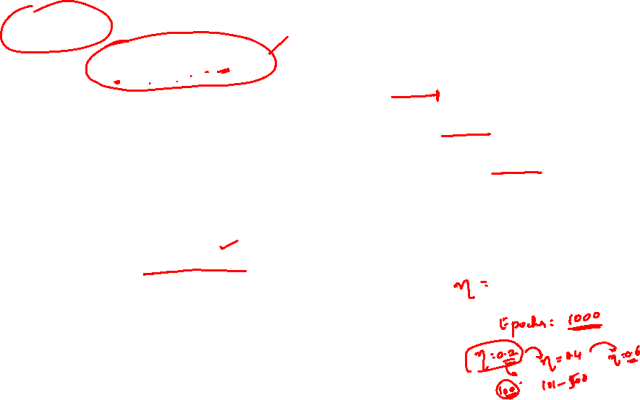

Slide 48


Slide 60


Slide 66

